Slide 1
Introduction
What is entrepreneurship?
What is special about small businesses?
How does one start a new venture?
What resources support entrepreneurship and business development?

Slide 2
Entrepreneurship
  Strategic thinking and risk-taking behavior that results in the creation of new opportunities for individuals and/or organizations.
Entrepreneurs
  Risk-taking individuals who take actions to pursue opportunities and situations others may fail to recognize or may view as problems or threats.

Slide 3
Entrepreneurs are …
  Founders of businesses that become large-scale enterprises.
  People who:
    Buy a local franchise outlet
    Open a small retail shop
    Operate a self-employed service business
  People who introduce a new product or operational change in an existing organization.

Slide 4
Typical characteristics of entrepreneurs:
  Internal locus of control
  High energy level
  High need for achievement
  Tolerance for ambiguity
  Self-confidence
  Passion and action-orientation
  Self-reliance and desire for independence
  Flexibility

Slide 5
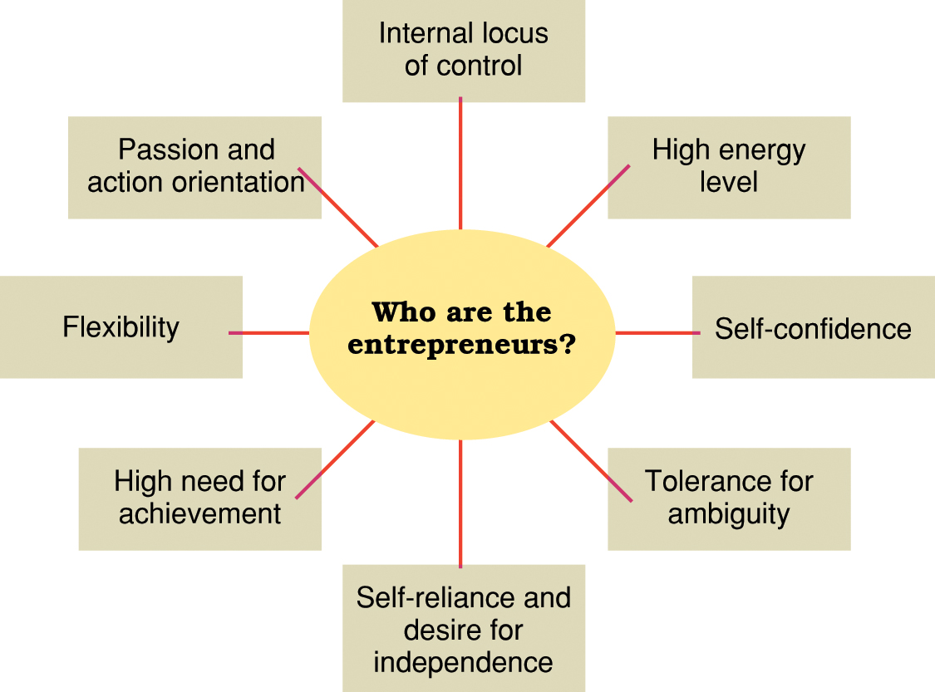
Personal traits and characteristics of entrepreneurs.

Slide 6
Typical entrepreneurial backgrounds and experiences:
  Parents were entrepreneurs or self-employed.
  Families encouraged responsibility, initiative, and independence.
  Have tried more than one business venture.
  Have relevant personal or career experience.
  Become entrepreneurs between 22 and 45 years of age.
  Have strong interests in creative production and enterprise control.
  Seek independence and sense of mastery.

Slide 7
Common myths about entrepreneurs:
  Entrepreneurs are born, not made.
  Entrepreneurs are gamblers.
  Money is the key to entrepreneurial success.
  You have to be young to be an entrepreneur.
  You must have a degree in business to be an entrepreneur.

Slide 8
THE CONCEPT OF AN ENTREPRENEUR
DEFINITION,NATURE AND CHARACTERISTICS OF AN ENTREPRENEUR
WORKING PROFILE OF AN INTREPRENEUR
TYPES OF ENTREPRENEUR
INTRAPRENEUR
FUNCTIONS OF AN ENTREPRENEUR
ENTREPRENEUR AND MANAGER----DISTINCTION

Slide 9
DEFINITION,NATURE AND CHARACTERISTICS OF AN ENTREPRENEUR
HISTORY:
The word ‘entrepreneur' is derived from the French word ‘entreprendre’which means ‘to undertake’. In the early 16th century the French men who organised and led military expeditions were referred to as ‘entrepreneur'. After 1700,the term was applied to other types of adventures, mainly civil engineering like constructions of roads etc.

Slide 10
DEFINITION
J.B.SAY: Is another Frenchman, expanded Cantillon’s ideas and conceptualised the entrepreneur as an organiser of the business firm, central to its distributive and productive functions.
E.E.HAGEN: The entrepreneur is an economic man,who tries to maximise his profits by innovations.
GALBRAITH: ‘People are poor because they prefer in that way’. An entrepreneur must accept the challenge and should be willing hard to achieve something.

Slide 11
CHARACTERISTICS OF AN ENTREPRENEUR
Calculated Risk-taker
Innovator
Organiser
Creative
Achievement Motivated
Technically Competent
Self-confident
Socially Responsible
Optimistic
Equipped with Capability to drive

Slide 12
11. Blessed with Mental Ability
Human Relations Ability
Communication Ability
Decision-Making
Business Planning
A venture Capitalist
Visionary
Entrepreneur make significant differences
Ability to Spot and Exploit Opportunities
Courage to Face Adversities
Leadership---An essential trait of the entrepreneur

Slide 13
MANAGER VERSUS LEADER
Manager Characteristics
Leader Characteristics
Administers
A copy
Maintain
Focus and systems and structure
Relies on control
Short-range view
Asks how and when
Eye on the bottom line
Imitates
Accepts the status quo
Classic good soldier
Does things right
Innovates
An original
Develops
Focuses on people
Inspires trust
Long-range perspective
Asks what and why
Eye on the horizon
Originates
Challenges the status quo
Own person
Does the right thing

Slide 14



WORKING PROFILE OF ENTREPRENEUR
Characteristics
Traits
Self-confidence
Drive
Task-result oriented
Risk-taker
Mental Ability
Leadership
Confidence, Independence, Optimism, Individuality.
Responsibility,Vigour, Initiative, persistence, Ambition.
Need for achievement, Profit-oriented, Energy.
Risk taking ability, Likes challenges.
Overall intelligence(IQ),Creative thinking, Analytical thinking ability.
Leadership behaviour, Gets alongwith others, Responsive to situations, Criticism.

Slide 15


Human Relations Ability
Originality
Communication Ability
Emotional stability, Healthy personal relations, Sociability, Tactfulness, Consideration.
Innovative, Creative, Resourceful, knowledge.
Perceptive, Foresight, Future oriented.

Slide 16

TYPES OF ENTREPRENEUR
According to the Type of Business
Business entrepreneur: Business entrepreneurs are those entrepreneurs who conceive the idea of a new product or service and then translate their ideas into reality.
Trading entrepreneur: As the very name indicates trading entrepreneur is concerned with trading activities and not manufacturing.
Industrial entrepreneur: As the very name indicates, an industrial entrepreneur is one who sets up an industrial unit.
Corporate entrepreneur: Corporate entrepreneur is the one who plans,develops and manages a corporate body.
Agricultural entrepreneur: Agricultural entrepreneur is the one who is engaged in the agricultural activities.

Slide 17

2. According to Motivation
Pure entrepreneur: Pure entrepreneur is one who may or may not possess an aptitude for entrepreneurship but is tempted by the monetary rewards or profits to be earned from the business venture.
Induced entrepreneur: Induced entrepreneur is attracted by the various incentives, subsidies and facilities offered by the government.

Slide 18

3.According to the Use of Technology
Technical entrepreneur: The strength of a technical entrepreneur is in his skill in production techniques. He concentrates more on production than on marketing.
Non-technical entrepreneur: Unlike technical entrepreneur, non-technical entrepreneur is not concerned with the technical aspect of the product rather he spends more time in developing alternative strategies of the marketing and distribution to promote his business.
Professional entrepreneur: Professional entrepreneur means an entrepreneur who is interested in floating a business but does not want to manage or operate it.

Slide 19

4.According to stages of Development
First generation entrepreneur: First generation entrepreneur are those entrepreneur who do not possess any entrepreneurial background.
Second generation entrepreneur: Second generation entrepreneur are those entrepreneurs who inherit the family business firms and pass it from one generation to another.
Classical entrepreneur: A classical entrepreneur is a stereotype entrepreneur whose aim is to maximize his economic returns at a level consistent with the survival of the unit but with or without an element of growth.

Slide 20
5.Classification Given by Danhof
Innovating entrepreneur: Innovative entrepreneurs are generally aggressive and possess the art of cleverly putting the attractive possibilities into practice.
Imitative entrepreneurs: Imitative entrepreneurs are characterised by readiness to adopt successful innovations inaugurated by successful innovating entrepreneurs.
Fabian entrepreneur: Fabian entrepreneurs are cautions and skeptical in experimenting change in their enterprises. Such entrepreneurs are shy, lazy and lethargic.
Drone entrepreneur: Drone entrepreneurs are characterised by a refusal to adopt opportunities to make changes in production formulae even at the cost of severly reduced returns.

Slide 21
6.According to Capital ownership
Private entrepreneur: When an individual or a group of individuals set up an enterprise, arrange finance, bear the risk and adopt the latest techniques in the business with the intention to earn profits, he or the group is called as private entrepreneur/entrepreneurs.
State entrepreneur: As the name indicates, state entrepreneur means the trading or industrial venture undertaken by the state or the government itself.
Joint entrepreneur: Joint entrepreneur means the combination of private entrepreneur and state entrepreneur who join hands.

Slide 22
7 According to Gender and Age
Man entrepreneur
Woman entrepreneur
Young entrepreneur
Old entrepreneur
Middle-aged entrepreneur

Slide 23
8.According to Area
Urban entrepreneur
Rural entrepreneur

Slide 24
9.According to Scale
Large scale industry entrepreneur
Medium scale industry entrepreneur
Small scale industry entrepreneur
Tiny industry entrepreneur

Slide 25

INTRAPRENEUR
The term ‘intrapreneur’ was coined in the United States of America in the late seventies.
Gifford Pinchot defined intrapreneurs as the persons who resigned from their well paid executive positions to launch their own ventures. Gifford devised the way by which such executives could be retained in the industry and their entrepreneurial urge was also satisfied by their bosses.
So a system was devised whereby such executives would operate as entrepreneurs with full independence and autonomy
but with
in the organisation.

Slide 26

Difference between entrepreneur and intrapreneur
An entrepreneur is an independence person who starts his venture and bears full risk of his failure and enjoys the fruit of his success whereas intrapreneur is partially independent and is sponsored by the corporation in which he is working. He is also not liable to bear the losses in case of his failure.
An entrepreneur raises the finance from various sources and also guarantees their return whereas an intrapreneur does not own responsibility to raise the capital or to return it.
An entrepreneur has no relation with any organisation whereas an intrapreneur operates within the organisation where he is working.

Slide 27

FUNCTIONS OF AN ENTREPRENEUR
There has been a great deal of confusion and contradiction in literature on the functions of an entrepreneur.
FUNCTIONS
Innovations: J.Schumpeter has made substantial contribution to the literature of entrepreneurship. The process of innovations may be in the form of:
Introduction of a new product.
Use of new methods of production.
Opening of a new market.
The conquest of new source of supply of raw material.
A new form of organisation.

Slide 28
2. Risk-taking: Richard cantillon states that entrepreneur is an agent who buys means of production at certain prices and sells them at uncertain prices.
The entrepreneur performs the function of reducing uncertainty in his plan of investment and expansion of the enterprise.
J.b. Say also stresses risk-taking as the specific function of an entrepreneur.
3. Decision Maker: Entrepreneur as a decision maker describes the following functions of an entrepreneur.
The determination of objectives of an enterprise and the change of those objectives as conditions required or made advantageous,
The development of an organisation including efficient relations with subordinates and all employees,

Slide 29
c) Securing adequate financial resources,the relations with existing and potential
Investors,
d) The acquisition of efficient technological equipment and the revision of it as new machinery appears,
e)The development of a market for the products and the devising of new products to meet or anticipate consumer’s demand,
f) The maintenance of good relations with public authorities and with society at large.

Slide 30
4. Organisation and Management: Marshall recognized organisation and management of the enterprise as the important functions of an entrepreneur.
When the organisation grows bigger, the entrepreneur effectively delegates authority and finds responsibility at various levels of management. The network of decision making becomes more complex.
The functions of organisation and management includes:
Planning of an enterprise,
Co-ordination, administration and control,
Routine type of supervision.

Slide 31
DISTINCTION BETWEEN AN ENTREPRENEUR AND A MANAGER
ENTREPRENEURS
MANAGERS
Status: An entrepreneur is the owner of his enterprise. He makes his own investment and owns his business.
Target: The main target of an entrepreneur is to start his venture by setting up as a sole-trader or firm or a company.
Status: A manager is just an employee in the enterprise which is owned and run by entrepreneur.
Target: The main goal or motive of a manager is give his services to an enterprise set up by someone else i.e. an entrepreneur.

Slide 32
ENTREPRENEURS
MANAGERS
3. Decision making: All of the policies and strategic decisions, like those comprising of expansion diversification, take-over etc are taken by the entrepreneur.
4.Rectification of wrong decisions: The wrong decisions taken by the entrepreneur may not be rectificable and may result in losses or even closure of the unit.
3. Decision making: While all those managerial, operational decisions which would have impact on the short-and medium-term results are taken by the managers.
4. Rectification of wrong decisions: Whereas the wrong decisions taken by the managers can be amended and rectified by the entrepreneur.

Slide 33
ENTREPRENEURS
MANAGERS
5. Innovations: An entrepreneur innovates and exploits his innovation commercially.
6. Risk bearing: An entrepreneur being the owner of his unit undertakes all risks and uncertainty of running his enterprise.
7. Skills: The skill expected from an entrepreneur is in the form of creativity, innovation, desire for high achievement, intuition etc.
5. Innovations: A manager is merely an officer or an executive who is appointed for the promotion of the unit.
6. Risk bearing: A manager doesn’t bear any risk because he is paid fixed salary.
7. Skills: Whereas manger depends on public dealing abilities and conceptual abilities.

Slide 34
ENTREPRENEURS
MANAGERS
8. Qualification: An entrepreneur doesn’t need to have distinct degree from a reputed university.
9. Rewards: The reward of an entrepreneur is the profit earned by him.
8. Qualification: On the other hand, a manager now a days need to possess degree in the stream of management theory and practice.
9. Rewards: A manager gets his monthly salary as his reward for the services rendered by him.

Slide 35
TO BECOME A SUCCESSFUL ENTREPRENEUR…..
Acquire sufficient and all-round knowledge about an enterprise you intend to start.
Be conservative in calculating income and lavish in calculating expenditure.
Don’t expect quick and easy returns from your venture.
Be prepared for delegation of work when needed.
Take moderate risks; neither too high nor too low.
Plan systematically and march ahead step by step according to the plan to achieve your goal.
Time management is necessary to maximum utilisation of your resources.
Collect maximum information about your competitor on continuous basis.
Don’t avoid or run away from problems.
Take the help of experts and experienced persons or erntrepreneur,when in doubt.

